Slide 1

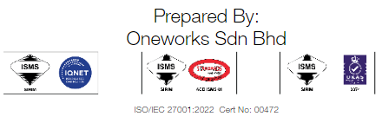
MONTHLY REPORTING FOR
Proton e.MAS
June 2026
Cut Off Date: 30 June 2026 23:59

Slide 2
Table of Contents
PeC Cases - Channel Analysis
PeC Incoming Channel Performance - Proton e.MAS Incoming Calls Analysis - Proton e.MAS Calls Average Handling Time
PeC Concern Analysis - Inquiry Analysis
- Complaint Analysis
- Feedback Analysis
PeC Dealer Analysis - Case Escalated To Dealers - Proton e.MAS Dealer Complaint Case Escalation Trends - Dealer Turnaround Time - Work In Progress (WIP) Cases
RSA Analysis
- RSA Call Analysis
Summary

Slide 3
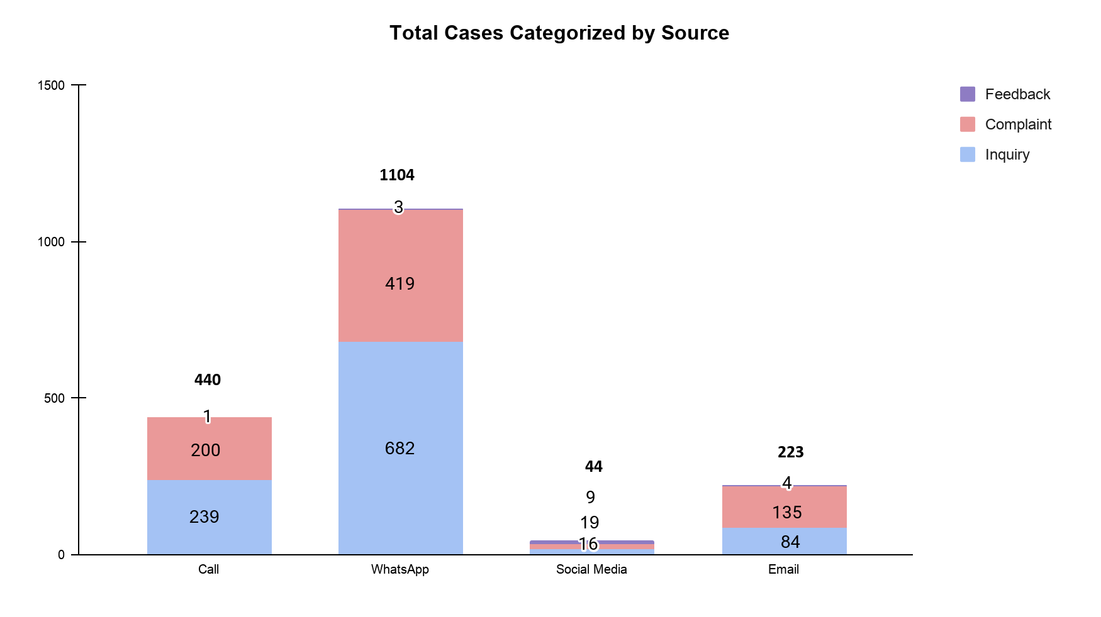
PeC Case Analysis According To Channel – June 2026
June 2026 Case Summary:
Total Cases : 1811
Inquiries : 1024
Complaints : 770
Feedback : 17
Key Insights in June 2026:
WhatsApp : 682 inquiries, 419 complaints, 3 feedback
Calls : 239 inquiries, 200 complaints, 1 feedback
Email : 84 inquiries, 135 complaints, 4 feedback
Social Media : 19 inquiries, 16 complaints, 9 feedback

Slide 4
Table of Contents
PeC Cases - Channel Analysis
PeC Incoming Channel Performance - Proton e.MAS Incoming Calls Analysis - Proton e.MAS Calls Average Handling Time
PeC Concern Analysis - Inquiry Analysis
- Complaint Analysis
- Feedback Analysis
PeC Dealer Analysis - Case Escalated To Dealers - Proton e.MAS Dealer Complaint Case Escalation Trends - Dealer Turnaround Time - Work In Progress (WIP) Cases
RSA Analysis
- RSA Call Analysis
Summary

Slide 5
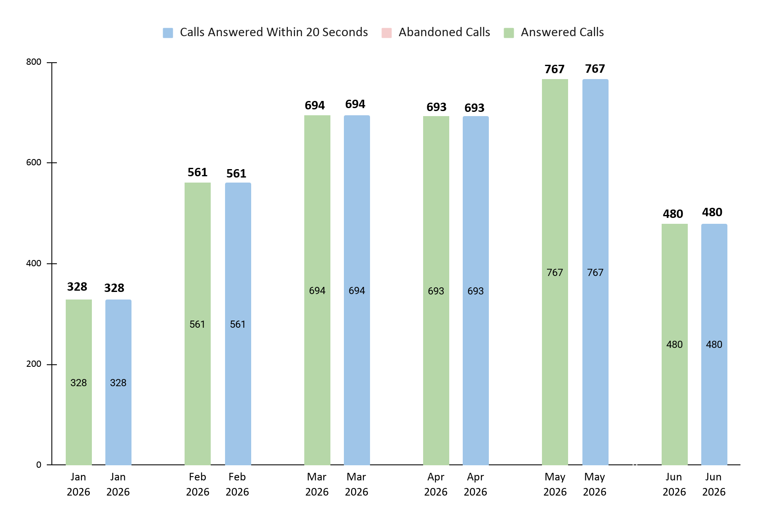
PeC Incoming Calls Analysis – June 2026
Month | Total number of incoming calls | Total number of calls answer | Total number of calls abandoned |  | % calls answered within 20 Seconds
 |  |  | Working Hours | Non - Working Hours
June 2026 | 480 | 480 | 0 | 0 | 100
June 2026 – PeC Customer Careline Call Performance
Total Inbound Calls : 480
Abandoned Calls : 0
SLA Within 20 Seconds : 100%
Chart shows answered, abandoned calls, and <20s response rate during operating hours.

Slide 6
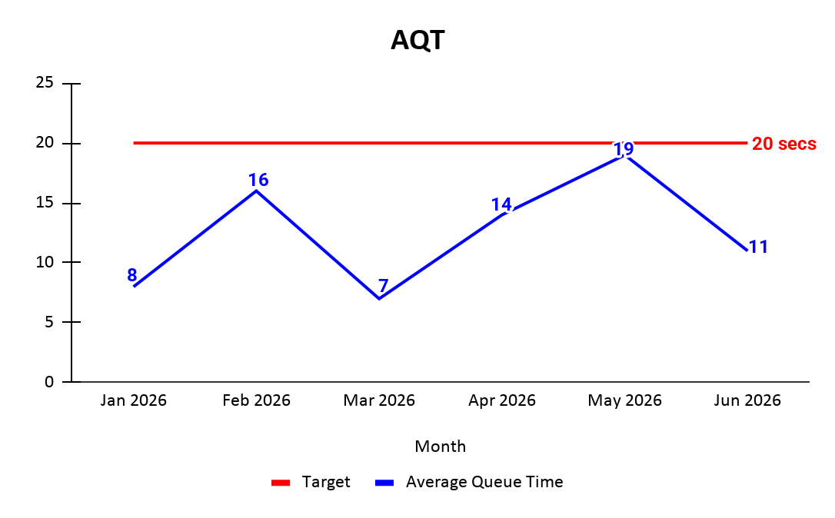
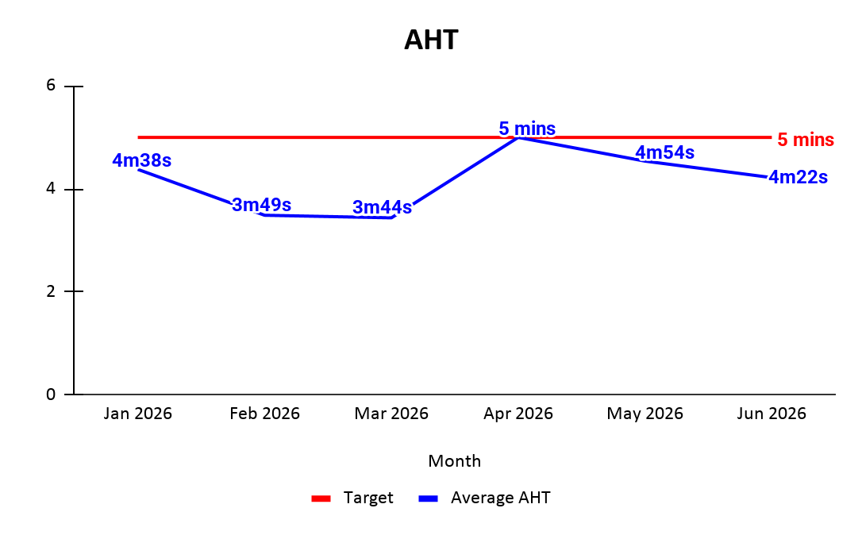
PeC Calls Average Queue & Handling Time – Jan to June 2026
*Calls Average Queue Time (AQT): The AQT calculation excludes the queue time for abandoned calls only during working hours. (Exclude misdial data)
*Calls Average Handling Time (AHT): The AHT calculation includes incoming calls during working hour and excludes RSA calls. (Exclude misdial data)
Chart above displays monthly AQT trend. Findings:
June AQT: 11 secs
Target (≤20 secs) consistently met, showing acceptable call handling efficiency
Chart above reflects AHT trend in June’26.
Findings:
AHT in June is 4 mins 22 seconds (within 5 min target)

Slide 7
Table of Contents
PeC Cases - Channel Analysis
PeC Incoming Channel Performance - Proton e.MAS Incoming Calls Analysis - Proton e.MAS Calls Average Handling Time
PeC Concern Analysis - Inquiry Analysis
- Complaint Analysis
- Feedback Analysis
PeC Dealer Analysis - Case Escalated To Dealers - Proton e.MAS Dealer Complaint Case Escalation Trends - Dealer Turnaround Time - Work In Progress (WIP) Cases
RSA Analysis
- RSA Call Analysis
Summary

Slide 8
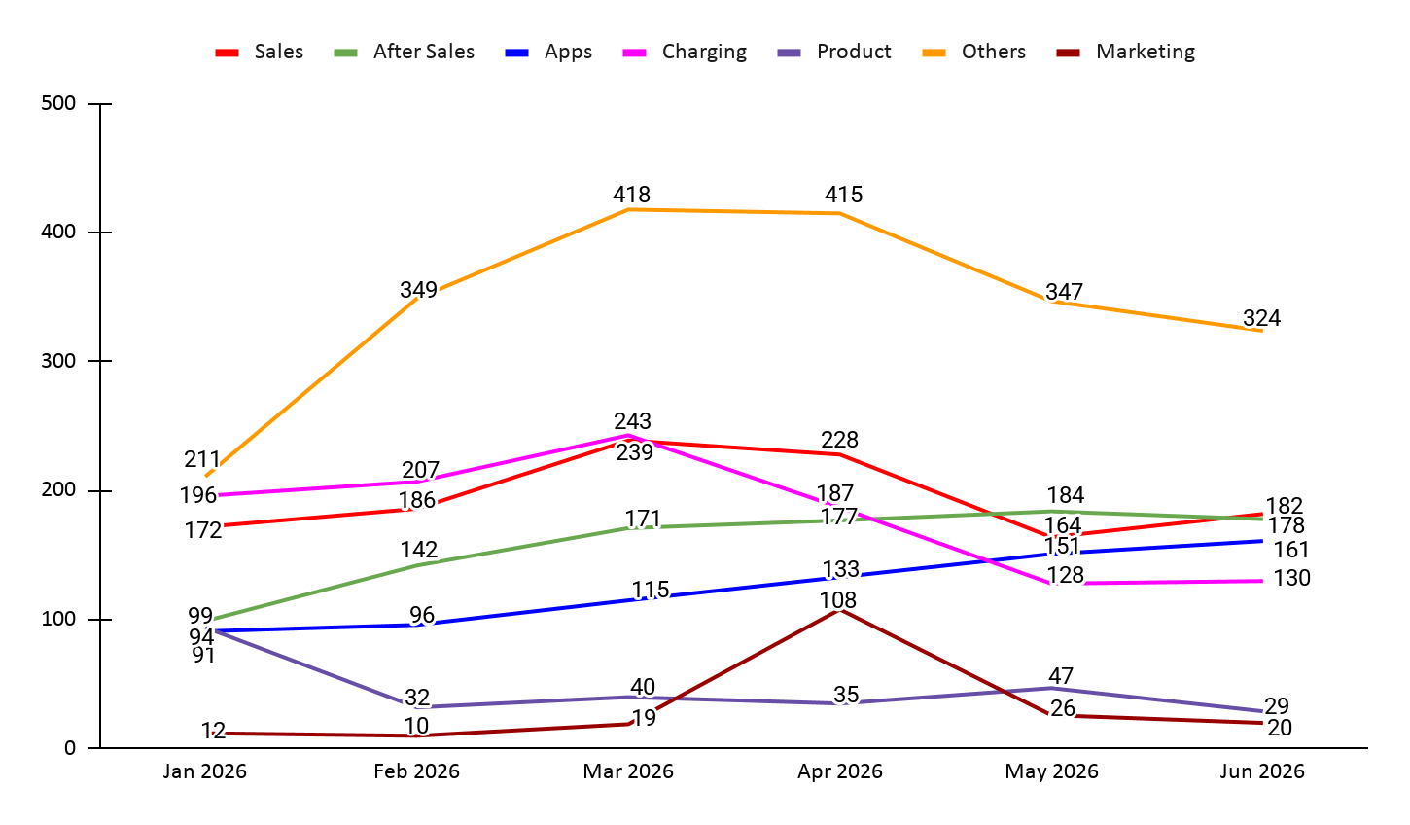
PeC Inquiry Trend – Jan to June 2026
Proton Inquiry Case Trends for June 2026:
Total Inquiry: 1024
After-Sales : 178 e.MAS 7 : 59, PHEV : 18
Sales : 182 e.MAS 5 : 63 , e.MAS 7 : 26, PHEV : 20
Apps : 161 e.MAS 5 : 42 , e.MAS 7 : 34, PHEV : 42
Charging : 130 e.MAS 5 : 28 , e.MAS 7 : 30, PHEV : 15
Product : 29 e.MAS 5 : 4, e.MAS 7 : 11, PHEV : 7
Marketing : 20 e.MAS 7 : 1 Others : 324 Not related to Proton e.MAS

Slide 9
PeC Inquiry Analysis for June 2026
Category | No. Case | Remarks
Sales: 182
Accessories | 28 | e.MAS 5 17 - Cargo cover / tonneau cover (complimentary entitlement, CKD vs CBU eligibility, collection process, availability, purchase) 1 - EV plate number e.MAS 7 1 - Lost key fob replacement 1 - Dashcam installation warranty e.MAS 7 PHEV 1 - Dashcam installation 1 - Complimentary package / purchase benefits Vehicle Model Not Mentioned 1 - Front bumper LED modification & warranty 1 - Dashcam beeping/noise 1 - 3-pin charger eligibility (early bird allocation / CKD entitlement) 1 - Cargo cover / tonneau cover
Booking | 23 | e.MAS 5 3 - Booking status / chassis number allocation / delivery timeline 1 - Vehicle information mismatch in e.MAS app (vehicle colour/booking record) 1 - Unable to view booking details in e.MAS app 1 - Vehicle availability enquiry (white Premium stock at dealer) e.MAS 7 1 - Customer booking not available in e.MAS app Vehicle Model Not Mentioned / Purchased 13 - Booking status / vehicle allocation / delivery timeline / booking queue 2 - Booking information (booking number / loan & booking) 1 - Vehicle purchase

Slide 10
PeC Inquiry Analysis for June 2026
Custom EV Plate (Frame) | 1 | e.MAS 5 1 - EV white plate collection status
Insurance | 13 | e.MAS 5 1 - e.MAS Care benefit & warranty/insurance coverage clarification e.MAS 7 4 - Insurance renewal / e.MAS Care renewal procedure 2 - Insurance package / e.MAS Care coverage 1 - Third-party accident insurance claim & repair procedure 1 - Loss of Use (LOU) insurance claim Vehicle model not mentioned/purchased 2 - Insurance package / quotation 1 - Insurance renewal procedure 1 - Roadside assistance coverage
New Model | 8 | e.MAS 5 2 - CKD release date / allocation enquiry 1 - CKD stock availability (Alabaster White interior) 1 - Vehicle colour viewing enquiry (Jade Green) e.MAS 7 PHEV 1 - CKD allocation enquiry 1 - CBU vs CKD allocation enquiry Vehicle model not mentioned/purchased 1 - New e.MAS model reveal / upcoming model enquiry 1 - Product suggestion (microcar / compact EV model)
Outlet | 1 | e.MAS 5 1 - Dealer / showroom contact request for vehicle booking

Slide 11
PeC Inquiry Analysis for June 2026
Promotion | 42 | e.MAS 5 8 - RM500 Raya Rebate (eligibility, status, refund, payment timeline) 3 - Corporate / Government rebate eligibility 1 - Rebate stacking / total rebate entitlement 1 - Power Financing programme 1 - Vehicle promotion enquiry e.MAS 7 2 - Trade-in rebate / promotion 2 - Government rebate eligibility 1 - Rebate refund status 1 - Loan / financing breakdown clarification e.MAS 7 PHEV 3 - Corporate / Government rebate eligibility 1 - PROTON Exchange refund status 1 - Power Trade-In rebate 1 - Matching Grant / old vehicle replacement rebate Vehicle model not mentioned / purchased 5 - Corporate / Government rebate eligibility, terms & conditions 2 - Vehicle promotion 2 - Trade-in promotion 1 - Golden Test Drive Campaign prize fulfilment 1 - Power Financing eligibility 1 - Roadshow booking 1 - Vehicle disposal programme enquiry (referred to Proton) 1 - Government pensioner rebate eligibility 1 - Corporate rebate dispute / verification process 1 - Corporate purchase programme
Refund | 5 | e.MAS 5 1 - Booking refund status e.MAS 7 1 - Booking fee refund request e.MAS 7 PHEV 1 - Booking refund processing timeline 1 - Booking cancellation & refund request Vehicle model not mentioned/purchased 1 - Refund process
Test Drive | 3 | e.MAS 5 2 - Test drive booking Vehicle model not mentioned/purchased 1 - Test drive appointment booking

Slide 12
PeC Inquiry Analysis for June 2026
Trade In | 2 | e.MAS 7 PHEV 2 - Trade-in programme / Carsome rebate enquiry (Power Trade In, Power Xchange, rebate eligibility)
Transfer Ownership | 8 | e.MAS 5 2 - Vehicle ownership transfer / change of ownership e.MAS 7 4 - Vehicle ownership transfer / change of ownership (including second-hand vehicle transfer, warranty transfer, unlink previous owner account) 1 - e.MAS app login / account access issue 1 - Wallbox & app access issue for pre-owned vehicle
Vehicle Delivery | 19 | e.MAS 5 8 - Vehicle delivery timeline / waiting period / booking queue status 2 - Vehicle allocation status / allocation procedure 1 - CKD variant delivery timeline 1 - Colour-specific delivery timeline (Jade Green availability & waiting period) e.MAS 7 PHEV 2 - Vehicle delivery status / estimated delivery date 1 - Premium Plus variant delivery timeline Vehicle model not mentioned/purchased 3 - Vehicle status / delivery timeline 1 - Vehicle location & showroom arrival status
Vehicle Details | 29 | e.MAS 5 3 - Vehicle stock availability / allocation 2 - CKD / CBU model information 2 - Vehicle specifications enquiry 2 - Product information (price, rebate, mileage & promotion) 1 - Booking / purchase information 1 - Sales / dealer information e.MAS 7 3 - Vehicle stock availability / allocation 1 - Product & specification enquiry e.MAS 7 PHEV 3 - Stock availability / allocation / waiting period 1 - Vehicle specifications enquiry (gross weight) 1 - Vehicle status enquiry 1 - Product information enquiry Vehicle Model Not Mentioned / Purchased 5 - Vehicle status / booking status 1 - Sales contact enquiry 1 - Vehicle stock availability 1 - Vehicle collection mileage enquiry

Slide 13
PeC Inquiry Analysis for June 2026
Category | No. Case | Remarks
After Sales: 178
Body | 4 | e.MAS 5 2 - Vehicle technical / aftersales concern 1 - Service / maintenance e.MAS 7 1 - Tail light fogging / condensation Vehicle model not mentioned 1 - Accident repair procedure
Roadside Assistance | 8 | e.MAS 7 3 - Roadside Assistance / towing request e.MAS 5 3 - Roadside Assistance / towing request 1 - Accident vehicle repair procedure Vehicle model not mentioned 1 - Roadside Assistance / towing request
Service / Recall Campaign | 2 | e.MAS 7 PHEV 2 - Service appointment / app service function
Service Operation | 126 | e.MAS 5 22 - Service appointment / booking 8 - Service interval / maintenance schedule 5 - Service centre contact / location 4 - Body & Paint / accident repair 2 - Claim submission status / warranty follow-up 1 - General service process e.MAS 7 28 - Service appointment / booking 11 - Service interval / maintenance schedule 5 - Service centre contact / location 3 - Alignment / wheel balancing / steering 4 - Repair status / parts delay e.MAS 7 PHEV 14 - Service appointment confirmation / booking 2 - Service interval / maintenance schedule 1 - Service centre contact / location 1 - Repair / inspection related Vehicle model not mentioned 10 - Service appointment / booking 3 - Service interval / maintenance schedule 2 - Service centre contact / location

Slide 14
PeC Inquiry Analysis for June 2026
Spare Part | 13 | e.MAS 5 1 - Door lock issue / vehicle part inspection 1 - Side mirror replacement / spare part clarification e.MAS 7 1 - Mirror accident damage / repair inspection 1 - Spare part warranty eligibility 1 - V2L adapter / part availability Vehicle model not mentioned 1 - Windscreen crack / insurance claim process 1 - Headlamp price 1 - Three-pin plug availability 1 - Spare part availability 1 - Spare parts purchasing / distribution 1 - Windscreen pricing 1 - Radiator replacement cost / spare part availability 1 - Equipment quotation request (tender)
Warranty | 11 | e.MAS 5 1 - Aftermarket lighting installation / warranty impact e.MAS 7 1 - Aftermarket spring buffer installation / warranty impact 1 - Dashcam installation / warranty impact e.MAS 7 PHEV 1 - E-hailing usage / warranty coverage clarification 1 - Plug-and-play power tailgate & dashcam installation / warranty impact Vehicle model not mentioned 1 - Windscreen crack / warranty & insurance coverage 1 - E-hailing usage / warranty coverage inquiry 1 - Insurance company hotline verification 1 - Windscreen paint mark & bare metal warranty claim 1 - Vehicle & battery warranty inquiry 1 - Dashcam hardwire installation / warranty impact

Slide 15
PeC Inquiry Analysis for June 2026
User Manual | 14 | e.MAS 5 1 - OBD port availability / dashcam installation inquiry 1 - Map navigation language setting assistance e.MAS 7 1 - Remote control battery replacement guidance 2 - Headlamp operation / temporary turn off inquiry 1 - Steering assist mode setting inquiry 1 - Adaptive Cruise Control (ACC) to Intelligent Cruise Control (ICC) setting 1 - AVM & dashcam footage viewing guidance 1 - Seat retreat / seat adjustment feature inquiry e.MAS 7 PHEV 1 - Wiper maintenance mode guidance 1 - Battery charging limit / charging habit inquiry 1 - Aircond power display reset guidance Vehicle model not mentioned 1 - Chassis number sticker placement clarification 1 - Battery charging limit feature suggestion

Slide 16
PeC Inquiry Analysis for June 2026
Category | No. Case | Remarks
Apps: 161
Information | 136 | e.MAS 7 20 - App & Vehicle Linking / Profile (QR code / Vehicle linking / App activation / Profile reactivation / Account deletion & recovery) 13 - Phone Number / Contact Update (Change phone number / Registered wrong number / OTP / Binding change) e.MAS 5 29 - App & Vehicle Linking / Profile (QR code / Vehicle linking / App activation / Profile reactivation / Account deletion & recovery) 22 - Phone Number / Contact Update Issues (Change phone number / Request to change number / Registered wrong number / Account re-registration issues) e.MAS 7 PHEV 21 - App & Vehicle Linking / Profile (QR code / Vehicle linking / App activation / Profile reactivation / Account deletion & recovery) 14 - Phone Number / Contact Update (Change phone number / Registered wrong number / Dealer update mismatch / Binding change) Vehicle model not mentioned/purchased 7 - App / Profile linking 10 - Phone Number / Contact Update
Operation | 5 | e.MAS 7 1 - Data usage explanation e.MAS 7 PHEV 2 - Data balance checking 1 - Data balance renewal 1 - Internet data balance viewing
User ID | 20 | e.MAS 7 3 - App login / account activation 1 - Vehicle status / ownership transfer 1 - App registration / login e.MAS 5 1 - App connectivity 1 - App registration & vehicle linking 1 - Security PIN / app settings 1 - Connected service / vehicle status 1 - Payment method setup e.MAS 7 PHEV 1 - Home assessment booking / account registration 3 - App registration / VIN number / App login 1 - Connected service / vehicle status Vehicle model not mentioned/purchased 4 - App / account access & connectivity 1 - TNG linking

Slide 17
PeC Inquiry Analysis for June 2026
Category | No. Case | Remarks
Charging: 130
Home Charging | 112 | e.MAS 5 16 - Home Assessment & Booking procedure (Booking, appointment, invoice, payment, reschedule) 9 - Wallbox & Charging inquiry (Installation, delivery, warranty, power, disconnects, charging procedure) e.MAS 7 19 - Home Assessment & Booking procedure (Booking, appointment, invoice, payment, reschedule) 10 - Wallbox & Charging inquiry (Installation, delivery, warranty, power, disconnects, charging procedure) e.MAS 7 PHEV 14 - Home Assessment & Booking inquiry (Booking, appointment, invoice) 9 - Wallbox installation & warranty Vehicle model not mentioned/purchased 16 - Home Assessment & Booking inquiry (Booking, appointment, invoice 19 - Wallbox & Charging inquiry (Installation, delivery, warranty, power, disconnects, charging procedure)
Public Charging | 18 | e.MAS 5 6 - Public Charging & Payment inquiry (Charging location, payment method, pre-authorization refund, charging session issue) e.MAS 7 8 - Public Charging & Payment inquiry (Charging location, charging process, payment setup, pre-authorization refund, charging session issue) Vehicle model not mentioned/purchased 4 - Public Charging & Charging procedure inquiry (Charging location, charging station connection, charging session guidance)

Slide 18
PeC Inquiry Analysis for June 2026
Category | No. Case | Remarks
Product: 29
Infotainment | 29 | e.MAS 7 11 - OTA / Software Updates & App / Vehicle System (OTA updates, version inquiries, pending updates, Flyme Auto, app issues, connected services, Bluetooth, navigation, TCAM, Android Auto, media player login, system bugs, software rollout, hardware/software mismatch) e.MAS 5 5 - Map, Navigation & Connected Services / Interior & Comfort (Map/Waze issues, favourite locations, time format, notifications, connected services, A-Store app, login issues, Android Auto, seat settings, data usage, child safety lock, pedestrian alert sound, feature) e.MAS 7 PHEV 8 - OTA / Charging & Connected Services (OTA updates, software version inquiries, charging-related connected features, data package, scheduled charging, V2V power output, network balance) Vehicle model not mentioned/purchased 5 - OTA / Software Updates & App / Vehicle System (General OTA questions, charging guidance, internet/data queries, app sync issues, charging procedure, system feature questions)
Marketing: 20
Event / Campaign | 4 | Vehicle model not mentioned/purchased 4 - Marketing Campaigns / Events (LIHAS 2026, KLIMS, MITEC Event)
Partnership / Collaboration | 13 | e.MAS 7 1 - EV content creator requested media review and test drive opportunity Vehicle model not mentioned/purchased 12 - Business collaboration proposals, charging vendor inquiry, EV product information request, dealer/distribution partnership, supplier collaboration, event proposals, media/content collaboration, network expansion proposals
Proposal | 3 | Vehicle model not mentioned/purchased 3 - EV charging solution proposals, EV charger manufacturing collaboration, marketing proposal

Slide 19
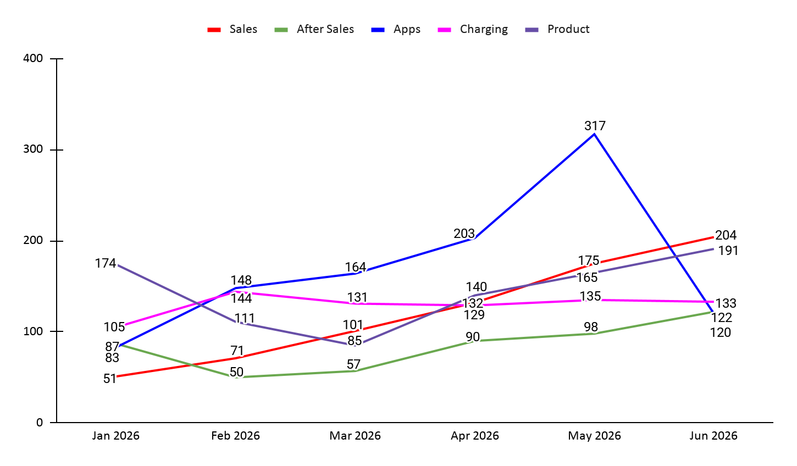
PeC Complaint Trend – June 2026
Proton Complaint Case Trends for June 2026:
Total Complaints: 770
Sales : 204 e.MAS 5 : 103 , e.MAS 7 : 20 , PHEV : 37
Product : 191 e.MAS 5 : 63 , e.MAS 7 : 86 , PHEV : 25
Charging : 133 e.MAS 5 : 47 , e.MAS 7 : 48 , PHEV : 19
After-Sales : 122 e.MAS 5 : 27 , e.MAS 7 : 72, PHEV : 14
Apps : 120 e.MAS 5 : 32 , e.MAS 7 : 40 , PHEV : 36
Summary:
In June 2026, complaints were highest in Sales (204 Cases) compared to others.
Key issues reported were Vehicle Allocation, Refund and Raya Rebate.

Slide 20
PeC Complaint Analysis for June 2026
Category | No. Case | Remarks
Charging: 133
Home Charging | 104 | e.MAS 5 15 - Unable to book Home Assessment / prior order / system issue / outbound process incomplete 9 - Wallbox malfunction / unable to charge / no power / red blinking issue 7 - Installation-related issue / installer delay / quotation / installation arrangement issue 3 - Home Assessment refund request / refund status follow-up / payment issue 1 - Wallbox charging / app synchronization issue 1 - Charging equipment issue / cable or connector defect 1 - Pending installation payment inquiry e.MAS 7 10 - Installation-related issue / installer delay / quotation / installation arrangement issue 8 - Wallbox malfunction / unable to charge / no power / red blinking issue 4 - Unable to book Home Assessment / prior order / system issue 4 - Charging issue / charging stopped unexpectedly / unable to start charging 3 - Wallbox power trip / RCCB trip / current drop issue 3 - Electrical concern / fuse overheating / DB issue / safety concern 1 - Home Assessment refund status inquiry 1 - Charging port not functioning 1 - Wallbox delivery delay after vehicle handover 1 - Wallbox charging connector detected but charging not started 1 - Wallbox replacement / warranty follow-up 1 - Wallbox charging/app synchronization issue e.MAS 7 PHEV 10 - Unable to book Home Assessment / phone number / prior order / system issue 4 - Installation-related issue / installer delay / assessment arrangement issue 2 - Wallbox malfunction / red blinking / unable to charge 1 - Request for wallbox inspection by PRO-NET technician 1 - Request to change installer 1 - Wallbox delivery delay after vehicle delivery 1 - Home charger overheating / electrical concern 1 - Wallbox charging not detected in app 1 - Home Assessment refund status inquiry

Slide 21
PeC Complaint Analysis for June 2026
Category | No. Case | Remarks
Charging: 133
Home Charging | 104 | Vehicle model not mentioned/purchased 3 - Unable to book Home Assessment / system issue 2 - Wallbox malfunction / unable to charge / no power 1 - Electrical safety concern / DB issue
Public Charging | 29 | e.MAS 5 9 - Public charging session issue / charging status stuck / unable to end charging session / app synchronization issue 2 - Charging gun unable to release / connector issue 1 - Billing issue / incorrect charging fee dispute e.MAS 7 9 - Public charging session issue / charging status stuck / unable to end charging session 2 - Charging failed / unable to start charging 1 - Pre-authorisation / payment issue 1 - Charging station availability / charger map issue e.MAS 7 PHEV 2 - Pre-authorisation / refund / payment issue 1 - Charging failed but payment/pre-authorisation deducted Vehicle model not mentioned/purchased 1 - Public charging billing / payment / charging session issue

Slide 22
PeC Complaint Analysis for June 2026
Category | No. Case | Remarks
Sales: 204
Accessories | 5 | e.MAS 5 3 - White EV plate delivery delay 1 - Vehicle accessories delay (Carpet) 1 - Touch N’ Go card delay
Customer Experience | 35 | e.MAS 5 7 - Poor sales advisor professionalism / communication 3 - Booking, refund, or purchase agreement dispute 2 - Promotional rebate dispute / delayed rebate 2 - Vehicle delivery condition / PDI quality issues 2 - 3-pin plug delivery delay 1 - Vehicle defect during vehicle delivery e.MAS 7 4 - Vehicle condition and delivery complaint 3 - Poor sales advisor / dealer service experience 1 - Delay NCD transfer e.MAS 7 PHEV 4 - Poor dealer / sales professionalism 2 - Vehicle condition and delivery complaint 1 - Delay vehicle registration Vehicle model not mentioned 3 - Poor dealer / sales professionalism 1 - Booking process delay

Slide 23
PeC Complaint Analysis for June 2026
Delivery | 128 | e.MAS 5 61 - No vehicle allocation / delivery delay / ETA delay 2 - Dealer communication issues / lack of updates 1 - Delay vehicle handover e.MAS 7 6 - No vehicle allocation / delivery delay / ETA delay e.MAS 7 PHEV 23 - No vehicle allocation / delivery delay / ETA delay 1 - Dealer communication issues / lack of updates 1 - Delivery quality / delivery rejection Vehicle model not mentioned 28 - No vehicle allocation / delivery delay 3 - Booking status 2 - Dealer communication issues
Promotion | 13 | e.MAS 5 6 - Raya / cash rebate claim delay 1 - Corporate Rebate Eligibility 1 - Proton Xchange / Scrappage Dispute e.MAS 7 1 - RM500 Rebate Claim Delay 1 - Promotion / Goodwill Compensation e.MAS 7 PHEV 2 - Rebate Status Delay (Power Exchange / Corporate Membership) Vehicle model not mentioned 1 - Government Rebate Eligibility Dispute

Slide 24
PeC Complaint Analysis for June 2026
Refund | 23 | e.MAS 5 7 - Booking Refund Delay / Cancellation Refund 2 - Booking Fee Refund Request (RM500 / RM99) e.MAS 7 5 - Booking Refund Delay / Cancellation Refund e.MAS 7 PHEV 3 - Booking Refund Delay / Cancellation Refund Vehicle model not mentioned 6 - Booking Refund Delay / Cancellation Refund

Slide 25
PeC Complaint Analysis for June 2026
Category | No. Case | Remarks
Product: 191
Infotainment | 143 | e.MAS 5 29 - 4G / Internet Connection / No Data / Signal / Connectivity Issue 8 - DHU / Infotainment / Login / Connected Services 2 - Audio / Display Issue 2 - Software update e.MAS 7 47 - 4G / Internet Connection / No Data / Signal Drop / “Abandon” Status Issue 10 - App / Connected Services / Login / VIN / QR Code / Location Issue 7 - DHU / Infotainment / Screen Blackout / Meter Display Issue 5 - Software update / OTA Version 2 - Feature / Software / Navigation / Android Auto Issue 2 - Vehicle Account Login / VIN & HU ID Mismatch After HDU Replacement 1 - Tyre pressure warning / Re-calibration issue 1 - Infotainment / camera delay after software update e.MAS 7 PHEV 9 - 4G / Internet Connectivity / Network Loss Issue 2 - App / Connected Services / System Sync Issue 1 - Spotify / DHU 1 - Infotainment / DHU inactive Vehicle Model Not Mentioned 11 - 4G / Internet / Network / Data Connectivity Issue 2 - DHU / Screen / Audio / System Blackout Issue 1 - DHU storage low
Telematics | 48 | e.MAS5 13 - App / Connected Services / Vehicle Sync / Data Not Updating / Connectivity Issue 4 - Unable to Connect / Remote Function Issue 3 - IHU Auto Logout / Login Issue / QR Code Generation 1 - Connection Timeout / DHU Connectivity Issue 1 - DHU Auto Shudown e.MAS7 11 - Vehicle Sync e.MAS7 PHEV 9 - App / Connected Services / Vehicle Sync / Data Not Updating Issue 2 - Vehicle Linking 1 - Internet Data Balance Vehicle model not mentioned 3 - App / Connected Services / Sync / Connectivity Issue

Slide 26
PeC Complaint Analysis for June 2026
Category | No. Case | Remarks
Apps: 120
Auto Logout | 2 | e.MAS 7 1 - App / Auto Logout e.MAS 7 PHEV 1 - App / Auto Logout
No QR Scanner | 73 | e.MAS 5 17 - No QR scanner / Unable to link app e.MAS 7 27 - No QR scanner / Unable to link app e.MAS 7 PHEV 21 - No QR scanner / Unable to link app Vehicle Model Not Mentioned 8 - No QR scanner
Notification | 3 | e.MAS 7 1 - Vehicle system warning e.MAS 7 PHEV 1 - Connected service disabled / Vehicle connectivity & charging status issue Vehicle Model Not Mentioned 1 - TPMS Low Tyre Pressure Warning Issue

Slide 27
PeC Complaint Analysis for June 2026
Profile | 17 | e.MAS 5 2 - Unable to login / registration / account linking issue 1 - OTP not received / OTP limit issue e.MAS 7 2 - Unable to login / app access issue 2 - OTP not received / OTP limit issue 1 - Booking details no displayed 1 - Charging status not updated e.MAS 7 PHEV 3 - Unable to login / account issue 3 - e.MAS App Profile / Personal Information Amendment 1 - Unauthorized Booking / Data Privacy Concern Vehicle Model Not Mentioned 1 - Unable to login / account issue
Remote Control | 9 | e.MAS 5 3 - Unable to control vehicle via app / all remote functions timing out e.MAS 7 2 - Unable to control vehicle via app / all functions timing out e.MAS 7 PHEV 3 - Unable to control vehicle via app / all functions timing out Vehicle Model Not Mentioned 1 - Unable to remote control car
Unable to update | 7 | e.MAS 5 7 - Apps not updating / troubleshooting required
Vehicle Order issue | 2 | e.MAS 5 1 - Booking details discrepancy Vehicle Model Not Mentioned 1 - Booking details discrepancy

Slide 28
PeC Complaint Analysis for June 2026
Category | No. Case | Remarks
After Sales: 122
ADAS | 2 | e.MAS 7 1 - Auto Emergency Braking System abnormal / AEB warning message detected e.MAS 7 1 - Auto Emergency Braking System abnormal / AEB warning message detected
Airbag | 3 | e.MAS 5 1 - Airbag failure warning e.MAS 7 1 - Airbag failure warning e.MAS 7 PHEV 1 - Airbag failure warning
Air Conditioner | 2 | e.MAS 7 1 - Air-Conditioning Odour 1 - Air-Conditioning Vent Defect
Body | 22 | e.MAS 5 3 - Sunroof rattling / leakage / dashboard creaking 3 - Body paint / dashboard cosmetic defect 2 - Undercarriage Cover Detached / Radiator Damage Concern e.MAS 7 6 - Sunroof rattling / water leakage / fender damage 2 - Vehicle alignment + camera system issue 1 - Air-Conditioning Vent Defect 1 - Wiper Noise Warranty Claim e.MAS 7 PHEV 1 - Driver Door Rattling Noise 1 - Tyre Crack / Warranty Replacement Issue Vehicle model not mentioned 1 - Rear Body Glue Residue 1 - Abnormal Roaring Noise

Slide 29
PeC Complaint Analysis for June 2026
Category | No. Case | Remarks
Electrical | 9 | e.MAS 5 1 - Electrical system / failure 1 - Driver seat adjustment malfunction 1 - Vehicle speaker no sound e.MAS 7 2 - Electrical system auto activation 1 - Driver seat adjustment malfunction e.MAS 7 PHEV 1 - Battery drain / low battery health / unlock & lighting inconsistency issue 1 - Parking sensor malfunction 1 - Vehicle headlamp auto turn on and off
Features | 18 | e.MAS 5 1 - Vehicle Door Lock/Unlock Malfunction 1 - Sudden Warning Alarm from Vehicle e.MAS 7 3 - DHU Display Failure / Bluetooth Connection Issue 2 - TPMS / Tyre Pressure Warning Issue 2 - Driver seat automatic adjustment issue 1 - Auto emergency braking system warning alert 1 - Electrical brake system warning notification 1 - High Voltage Battery System Warning 1 - Front Cross Traffic Alert Malfunction 1 - Meter Cluster Turn Signal Indicator Issue 1 - Unexpected Camping Mode Activation e.MAS 7 PHEV 1 - Drive Mode Sound Issue After Software Update 1 - Dashcam Error Warning 1 - Headlamp Auto Activation After Software Update

Slide 30
PeC Complaint Analysis for June 2026
Service Operation | 41 | e.MAS 5 5 - Unable to book service appointment / appointment system error 2 - Radiator issue (stone impact damage, repair delay, warranty dispute) 1 - Service pricing discrepancy / overcharging concern 1 - Wrong service interval information provided by Sales Advisor 1 - Accident repair / insurance claim delay e.MAS 7 20 - Unable to book service appointment / appointment system error (including app booking failure, ongoing appointment not updated, cancelled appointments) 1 - Service maintenance reminder not updated / wheel alignment dissatisfaction 1 - Service centre delay in software part replacement / poor dealer communication 1 - New vehicle quality issues and dealer handling complaint (steering alignment, suspension, dent, trim fitting) 1 - Accident investigation follow-up (unintended acceleration, brake and airbag concerns) 1 - Courtesy vehicle / rental reimbursement request during repair 1 - Vehicle repair status / parts arrival update 1 - New vehicle defects (rear lamp crack, loose rear A/C vent) 1 - Accident shortly after delivery (information sharing, no vehicle quality concern) e.MAS 7 PHEV 1 - Incorrect service appointment displayed in app 1 - Service centre incident / vehicle damaged during servicing 1 - Service centre handling complaint (door scratch, referred between Service Centre and Body & Paint)

Slide 31
PeC Complaint Analysis for June 2026
Spare Part | 6 | e.MAS 7 1 - Vehicle key detection error (troubleshooting pending customer verification) 3 - Spare part delay / replacement status not updated (windshield, bumper, clock spring) 1 - Accident repair delay due to multiple outstanding spare parts / prolonged repair after collision e.MAS 7 PHEV 1 - Spare part delivery delay for insurance repair (parts not received after insurance approval)
Steering | 1 | e.MAS 7 1 - Multiple vehicle quality issues (rattling/abnormal noise) and connectivity performance issue [Rattling noise from door trims, steering shroud, steering column, B/C-pillars, and tailgate]
Suspension | 3 | e.MAS 7 1 - Loud fan noise 2 - Suspension / ride comfort issue (excessive bouncing, unstable ride quality)
Technical | 10 | e.MAS 5 1 - Recurring AC/DC charging failure and vehicle account login/logout issue e.MAS 7 1 - Multiple vehicle quality issues reported after new vehicle delivery (noise, USB charging, reverse camera, interior/exterior defects, requested vehicle exchange) 1 - High voltage warning / abnormal vehicle noise 1 - Radio no sound issue 1 - 360° camera malfunction 1 - Vehicle shuts down after start-up 1 - Repeated vehicle breakdown / charging failure and wireless charger issue 1 - Tyre stability issue while driving e.MAS 7 PHEV 1 - Engine oil health reading abnormal (low mileage) 1 - Suspected engine oil leak / engine compartment contamination on new vehicle delivery
Warranty | 5 | e.MAS 7 1 - Warranty replacement parts delay e.MAS 5 1 - Driver seat cover torn 2 - Radiator leak warranty dispute (stone impact damage / reimbursement request) 1 - Vehicle delivery defects (cracked glass near DHU and missing carpet)

Slide 32
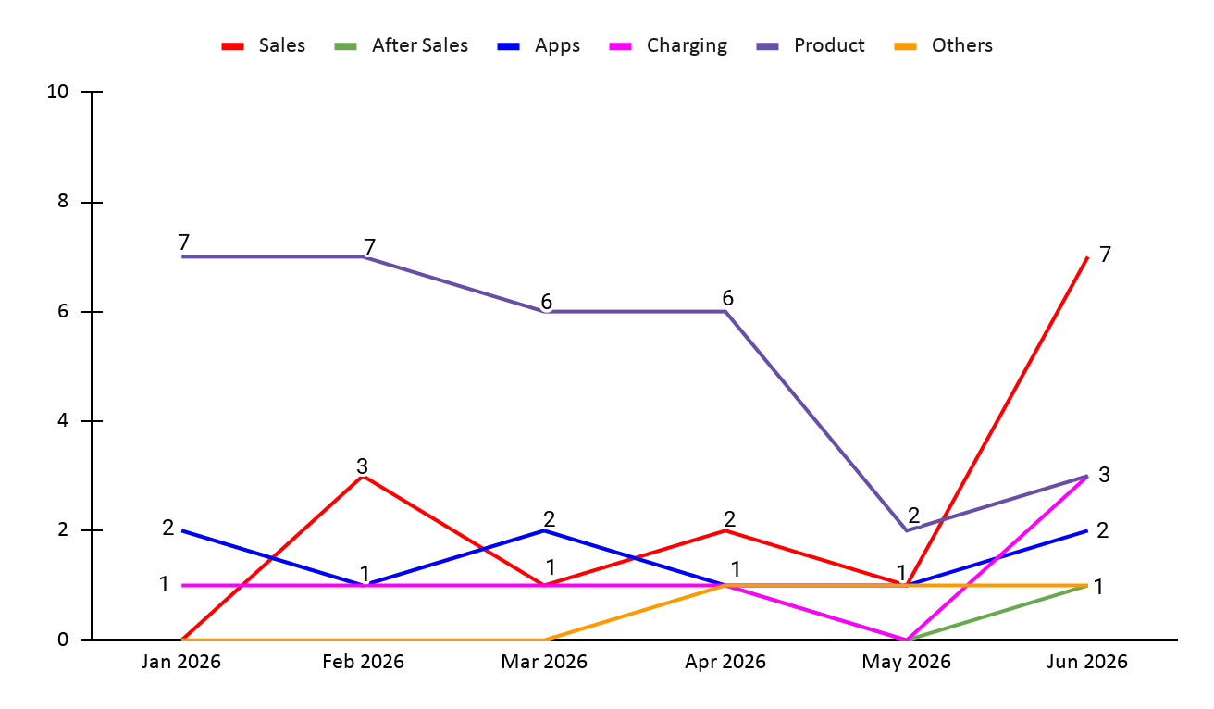
PeC Feedback Trend – June 2026
Proton Compliment & Feedback Case Trends for June 2026:
Total Feedback: 17
Sales : 7 e.MAS 5 : 2 , e.MAS 7 : 3
After-Sales : 1
Apps : 2
Product : 3 e.MAS 7 : 2
Charging : 3 e.MAS 5 : 1 , e.MAS 7 : 1
Others : 1 e.MAS 7 : 1
Summary:
In June, feedback for Sales showed constant trend.

Slide 33
PeC Compliment / Feedback Analysis for June 2026
Category | No. Case | Remarks
Product: 3
Features | 3 | e.MAS 7 1 - To display gear position on e.MAS 7 PHEV HUD via OTA 1 - To add occupant sensors for all vehicle seats Vehicle model not mentioned 1 - Android auto stability & lane keep assist default settings
Apps: 2
Content | 1 | Vehicle model not mentioned 1 - Feedback on Proton e.MAS community group moderation 1 - Suggestions for Proton e.MAS app enhancement for charging
Sales: 7
Staff | 1 | e.MAS 5 1 - Compliment on sales advisor service
Others | 6 | e.MAS 5 2 - Price reduction e.MAS 7 1 - Feature Enhancement Request 1 - Feedback on regen & drive mode memory functionality Vehicle model not mentioned 1 - Ownership experience 1 - EV number plate regulations
After Sales: 1
Others | 1 | Vehicle model not mentioned 1 - Suggestion for Proton e.MSSAS network expansion in Taiping
Charging: 3
Public Charging | 3 | e.MAS 5 1 - EV charging infrastructure expansion & reliability e.MAS 7 1 - EV driving range & charging availability for long-distance travel Vehicle model not mentioned 1 - Request to include residential EV chargers in PRO-NET charging network
Others: 1
Others | 1 | 1 - e.MAS 7 ride comfort & suspension performance

Slide 34
Table of Contents
PeC Cases - Channel Analysis
PeC Incoming Channel Performance - Proton e.MAS Incoming Calls Analysis - Proton e.MAS Calls Average Handling Time
PeC Concern Analysis - Inquiry Analysis
- Complaint Analysis
- Feedback Analysis
PeC Dealer Analysis - Case Escalated To Dealers - Proton e.MAS Dealer Complaint Case Escalation Trends - Dealer Turnaround Time - Work In Progress (WIP) Cases - Temp Close Cases
RSA Analysis
- RSA Call Analysis
Summary

Slide 35
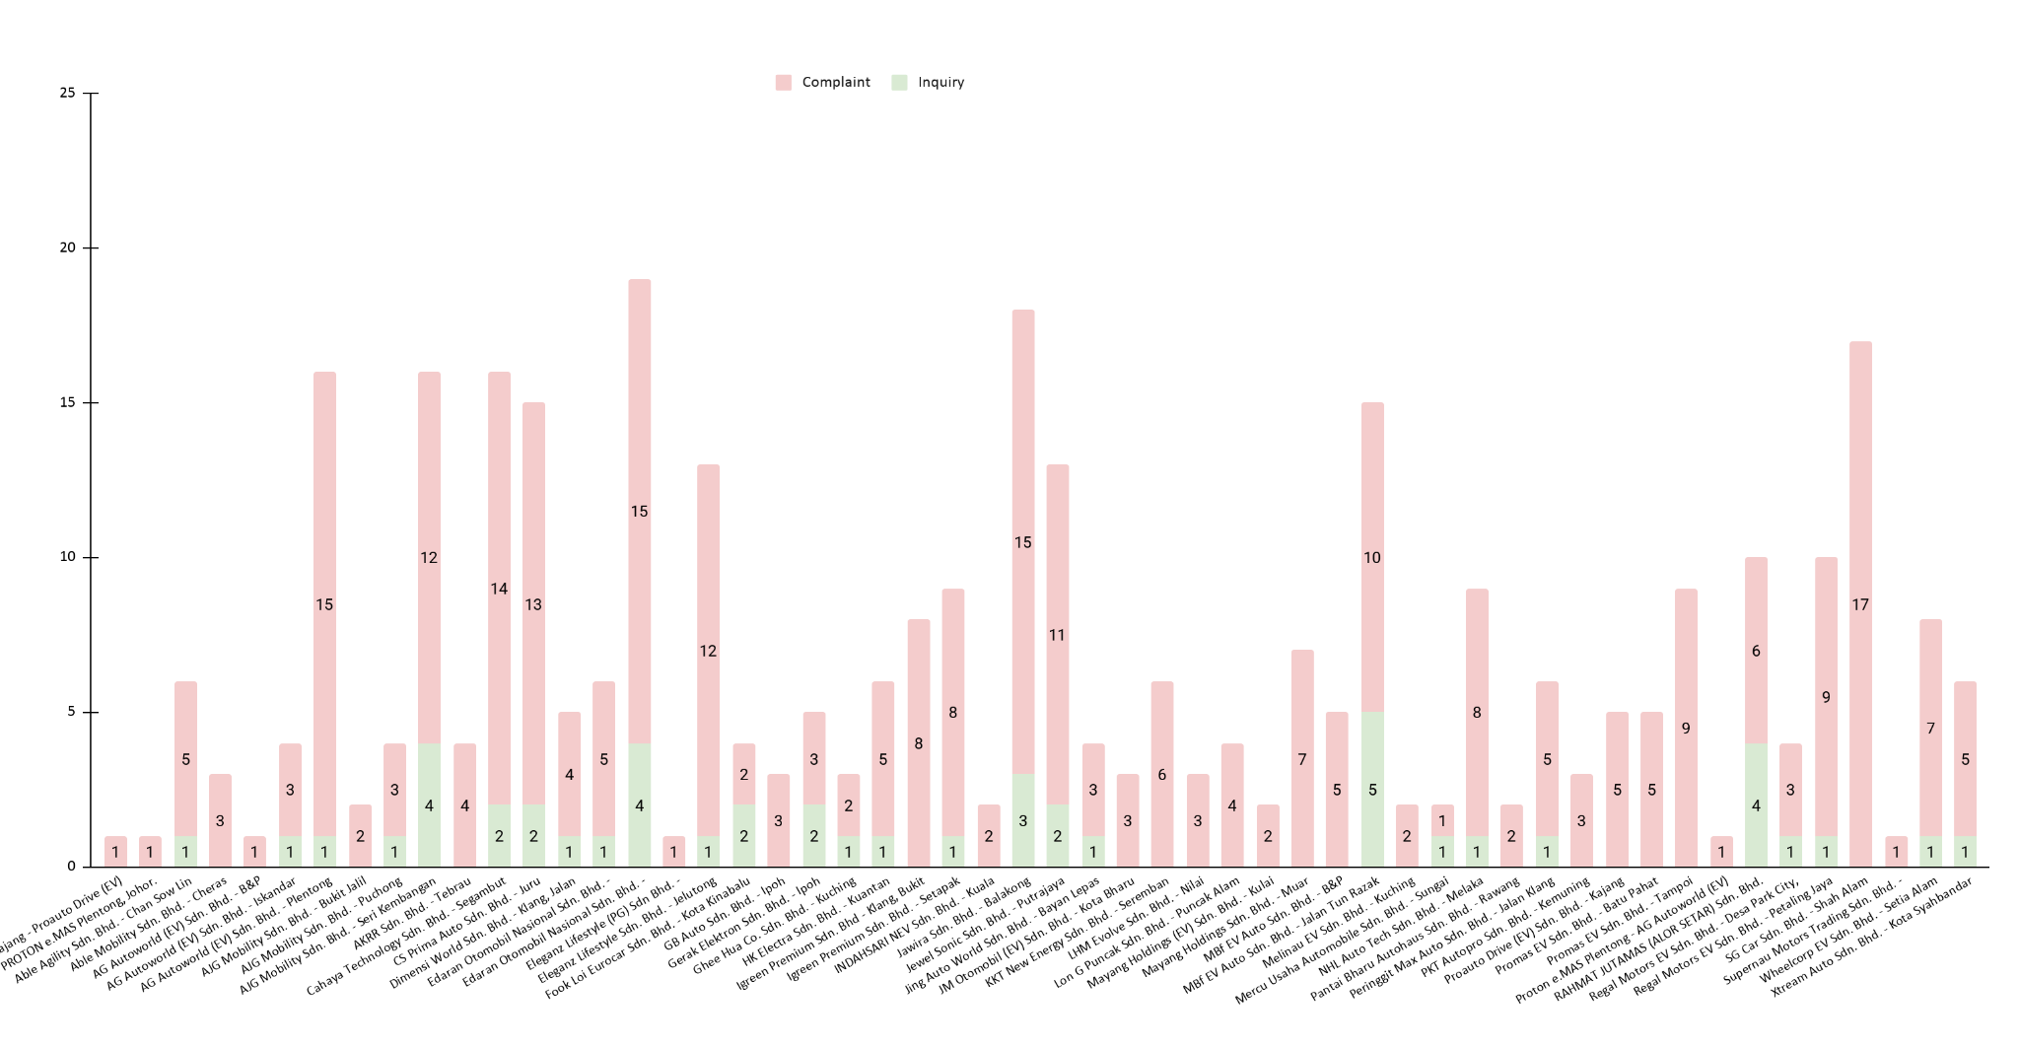
PeC Cases Escalated To Dealers – June 2026
Cases Handle by Dealer:
Total Cases : 1811
• Escalated to Dealers : 353
• Escalated to HQ : 245
• N/A (No escalation needed) : 1213
N/A: refers to cases resolved without dealer involvement

Slide 36
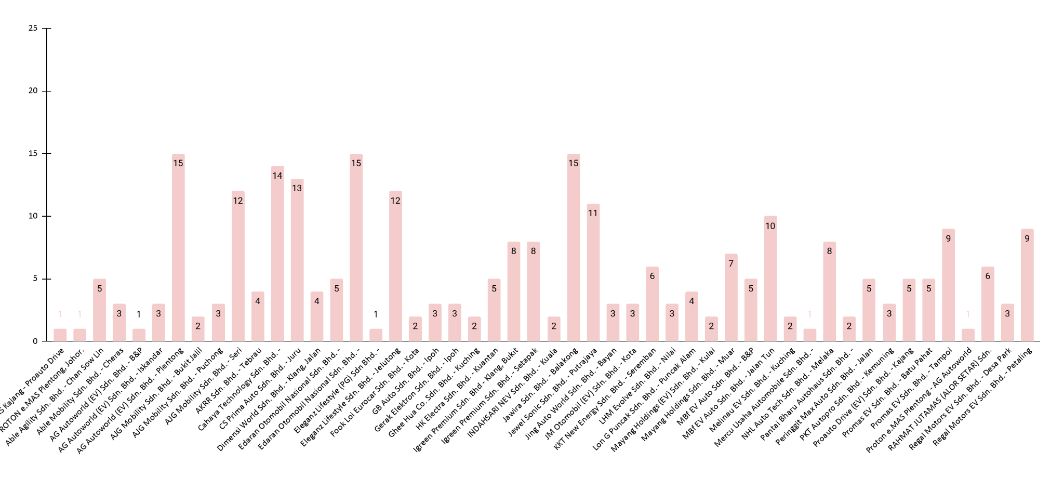
PeC Complaint Trend: Cases to Dealers – June 2026
Proton e.MAS Complaint Trend: Cases to Dealers – June 2026
The chart above shows the complaint cases trend by respective dealers for June 2026. Total 353 cases escalated to dealer.
Proauto Drive (Kajang) : 1
Proton e.MAS Plentong : 1
Able Agility : 5
Able Mobility : 3
AG Autoworld B&P : 1
AG Autoworld Iskandar Puteri : 3
AG Autoworld Plentong : 15
AJG Mobility (Bukit Jalil) : 2
AJG Mobility (Puchong) : 3
AJG Mobility (Seri Kembangan) : 12
AKRR (Tebrau) : 4
Cahaya Technology : 14
CS Prima Auto : 13
Dimensi World : 4
EON Damansara : 5
EON Glenmarie : 15
Eleganz Lifestyle (Butterworth) : 1
Eleganz Lifestyle (Jelutong) : 12
Fook Loi Eurocar : 2
GB Auto : 3
Gerak Elektron : 3
Ghee Hua : 2
HK Electra : 5
Igreen Premium (Bukit Tinggi) : 8
Igreen Premium (Setapak) : 8
Indahsari NEV : 2
Jawira : 15
Jewel Sonic : 11
Jing Auto World : 3
JM Otomobil : 3
KKT New Energy : 6
LHM Evolve : 3
Lon G Puncak : 4
Mayang Holdings (Kulai) : 2
Mayang Holdings (Muar) : 7
MBf EV Auto B&P : 5
MBf EV Auto (Jln Tun Razak) : 10
Melinau EV : 2
Mercu Usaha Automobile : 1
NHL Auto Tech : 8
Pantai Bharu Autohaus : 2
Peringgit Max Auto : 5
PKT Autopro : 3
Proauto Drive : 5
Promas EV (Batu Pahat) : 5
Promas EV (Tampoi) : 9
Proton e.MAS Plentong (AG) : 1
Rahmat Jutamas : 6
Regal Motors (Desa ParkCity) : 3
Regal Motors (Petaling Jaya) : 9
SG Car : 17
Supernau Motors : 1
Wheelcorp EV : 7
Xtream Auto : 5

Slide 37
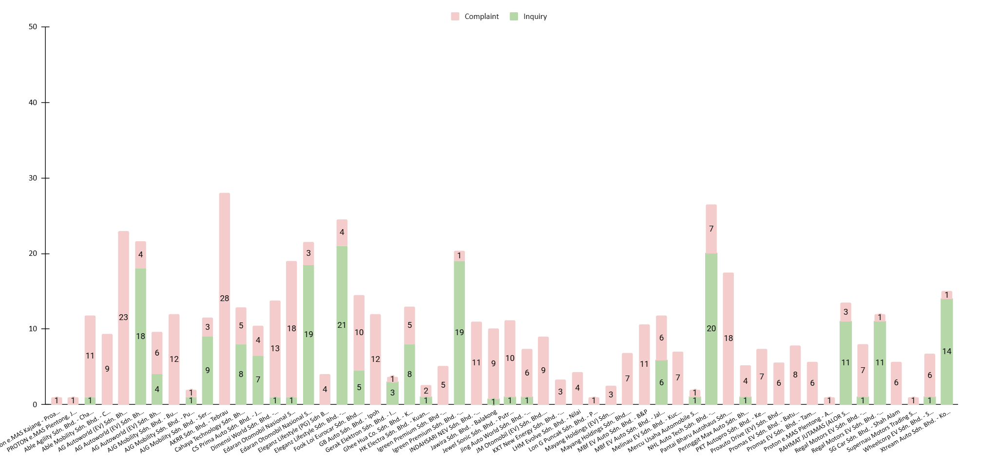
Dealer Average Turnaround Time (Day) – June 2026
Average Turnaround Time by Dealers:
🚨 Slowest Resolution Times:
AG Autoworld Plentong (B&P) – 23 days (Parts delay (bumper)
• Case resolution was prolonged due to delays in spare parts ordering caused by the implementation of the new B&P Dealer Code and pending PRO-NET approval. Additional time was required while awaiting the customer's availability to schedule the repair after the part arrived.
EON Damansara – 18 days (Pending rebate refund)
• Case resolution was delayed due to awaiting dealer verification and confirmation of the Raya rebate refund. The vehicle registration plate issue was clarified to be under JPJ's jurisdiction and outside the dealer's authority.
AKRR (Tebrau) / ACOTECH – 28 days (No QR scanner & vehicle not sync with apps)
• Case resolution was delayed due to technical investigation by ACOTECH and repeated follow-up with the customer to verify the issue after troubleshooting. The case was eventually closed after no response was received from the customer.

Slide 38
WIP Case – June 2026 (Latest update was on 20 July)
Complaint
No. | Case ID | Case Division | Concern | Purchased From | Escalated To | Car Plate | Duration (Days) | Prolonged Duration Mainly Due To:
1 | 080626-PROEV-32070 | Sales | Customer Experience | MBf EV Auto Sdn. Bhd. - Jalan Tun Razak | MBf EV Auto Sdn. Bhd. - Jalan Tun Razak | NA | 42 | Awaiting dealer's investigation and response regarding the customer's complaint.
2 | 150626-PROEV-32545 | After Sales | Warranty | Wheelcorp EV Sdn. Bhd. - Setia Alam | Wheelcorp EV Sdn. Bhd. - Setia Alam | SJR8168 | 35 | Awaiting dealer's confirmation on the warranty repair status following case reopening.
3 | 190626-PROEV-32775 | Product | Telematics | Proton e.MAS Kota Kinabalu - Fook Loi Eurocar | (ACOTECH) | SS74L | 31 | Awaiting ACOTECH investigation and customer confirmation on app synchronisation issue.
4 | 210626-PROEV-32867 | Apps | Remote Control | Proton e.MAS Kuantan - HK Electra | (ACOTECH) | CDX4545 | 29 | Awaiting ACOTECH investigation and PRO-NET update on remote control issue.
5 | 240626-PROEV-33106 | After Sales | Technical | Edaran Otomobil Nasional Sdn. Bhd. - Glenmarie | Edaran Otomobil Nasional Sdn. Bhd. - Glenmarie | BSC3866 | 26 | Awaiting dealer's response regarding the customer's compensation request following repeated breakdowns.
6 | 300626-PROEV-33488 | Charging | Home Charging Installation | Proton e.MAS Puchong - AJG Mobility | Proton New Energy Technology Sdn. Bhd. (Charging Team) | MEE2788 | 20 | Awaiting Charging Team's update on the wallbox installation rectification.

Slide 39
WIP Case – June 2026 (Latest update was on 20 July)
Inquiry
No. | Case ID | Case Division | Concern | Purchased From | Escalated To | Car Plate | Duration (Days) | Prolonged Duration Mainly Due To:
1 | 050626-PROEV-31789 | Sales | Transfer Ownership | NHL Auto Tech Sdn. Bhd. - Melaka | Proton New Energy Technology Sdn. Bhd. | BSH2345 | 45 | Awaiting HQ (Rapheal) to process the transfer of ownership request.
2 | 050626-PROEV-31812 | Sales | Transfer Ownership | Edaran Otomobil Nasional Sdn. Bhd. - Glenmarie | Edaran Otomobil Nasional Sdn. Bhd. - Glenmarie | BSH9098 | 45 | Awaiting dealer to process the transfer of ownership and registered phone number update.
3 | 250626-PROEV-33151 | Sales | Transfer Ownership | Eleganz Lifestyle Sdn. Bhd. - Jelutong | Eleganz Lifestyle Sdn. Bhd. - Jelutong | VRF6628 | 25 | Awaiting dealer to process the transfer of ownership request.

Slide 40
Table of Contents
PeC Cases - Channel Analysis
PeC Incoming Channel Performance - Proton e.MAS Incoming Calls Analysis - Proton e.MAS Calls Average Handling Time
PeC Concern Analysis - Inquiry Analysis
- Complaint Analysis
- Feedback Analysis
PeC Dealer Analysis - Case Escalated To Dealers - Proton e.MAS Dealer Case Escalation Trends - Dealer Turnaround Time - Work In Progress (WIP) Cases
RSA Analysis
- RSA Call Analysis
Summary

Slide 41
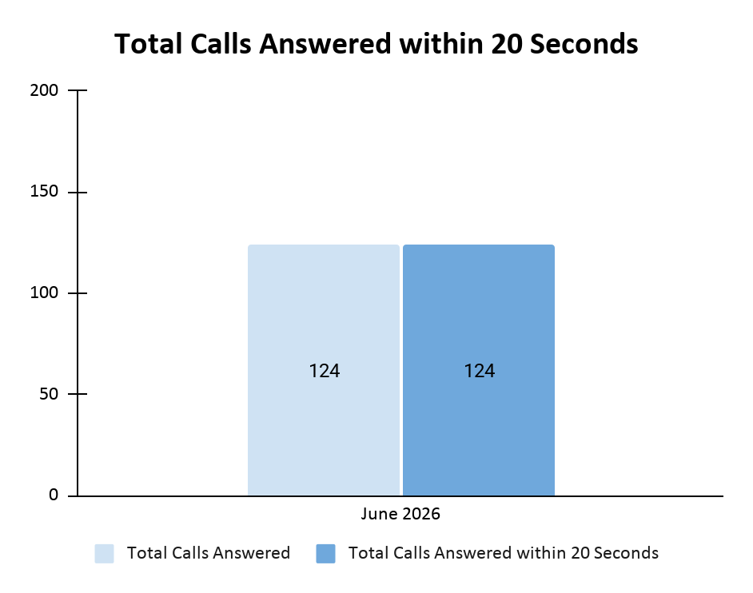
RSA Case Analysis – June 2026
Month | Total Number Of Incoming Calls | Total Number Of Calls Answer | Total Number Of Calls Abandoned | Total Number Of Calls Answered Within 20 Seconds | % Calls Answered Within 20 Seconds
June | 124 | 124 | 0 | 124 | 100%
June RSA Call Performance:
In June, there is no abandon call.
Out of 124 received calls, there were 59 RSA cases in June.
The remaining RSA calls were general inquiries, and customers were informed to select the correct extension to be connected to the PeC.

Slide 42
RSA Case Analysis – June 2026
Incident Date | Vehicle Number | Model | Dealership/Workshop | Customer Called In Time | Towing Assigned Time | Time Arrived Breakdown Area | Time Arrived Outlet | Total KM | Late Reason | Remarks
1 Jun 2026 | VPP8636 | e.MAS 7 | Proton e.MAS - Wheelcorp EV (Setia Alam - SVC) | 9:42 am | 9:48 am | 10:09 am | 10:30 am | 8 |  | Water leaking
1 Jun 2026 | QBJ1419 | e.MAS 7 | Eco Tyre Shop (Car Service and Tyres centre) | 5.45 pm | 6:00 pm | 6:10 pm | 6:30 pm | 19 |  | Flat Tyre
1 Jun 2026 | ST1111X | e.MAS 7 | DC Handal Charging Station | 9:43 pm | 9:55 pm | 11:25 pm | 3:35 am | 66 |  | Flat Battery
1 Jun 2026 | VQG564 | e.MAS 7 | Petronas R&R @ Bentong | 10:11 pm | 10:25 pm | 11:22 pm | 11:50 pm | 18 |  | Flat Battery
1 Jun 2026 | APG842 | e.MAS 5 | Syarikat Kong Wah, Kuala Lumpur | 8:01 pm | 8:01 pm | 8:53 pm | 12:15 am | 137 |  | Flat Tyre
3 Jun 2026 | P503P | e.MAS 7 | Proton e.MAS - Able Agility Sdn. Bhd. (Chan Sow Lin - SVC) | 7:43 am | 7:58 am | 8:45 am | 9:23 am | 8 |  | Unable to Start
3 Jun 2026 | UMT616 | e.MAS 7 | ChargeSINI Charging Station | 9:38 pm | 9:57 pm | 11:25 pm | 11:51 pm | 1 |  | Flat Battery
5 Jun 2026 | QM2100U | e.MAS 7 | R&R Paka West Bound | 5:22 pm | 6:22 pm | 7:00 pm | 7:45 pm | 12 |  | Flat Battery
5 Jun 2026 | VRA7522 | e.MAS 5 | Home: 22a, Jalan Ulek Mayang 1B/KU5, Klang | 5:27 pm | 5:28 pm | 6:01 pm | 8:22 pm | 33 |  | Flat Tyre
5 Jun 2026 | VQH2546 | e.MAS 5 | Y & K Auto Service Centre | 6:58 pm | 7:31 pm | 8:15 pm | 9:35 pm | 23 |  | Flat Tyre
5 Jun 2026 | VIPS9765 | e.MAS 7 | Proton e.MAS - Regal Motors EV (Petaling Jaya - SVC) | 9:57 pm | 10:00 pm | 10:45 pm | 11:20 pm | 9 |  | Flat Tyre
7 Jun 2026 | ANN7111 | e.MAS 5 | FastFit (Cheras) - Tyres, Premium Rims & Car Service | 6:57 pm | 7:16 pm | 7:55 pm | 8:10 pm | 9 |  | Flat Tyre

Slide 43
RSA Case Analysis – June 2026
Incident Date | Vehicle Number | Model | Dealership/Workshop | Customer Called In Time | Towing Assigned Time | Time Arrived Breakdown Area | Time Arrived Outlet | Total KM | Late Reason | Remarks
8 Jun 2026 | FC9278 | e.MAS 7 | Proton e.MAS - Wheelcorp EV (Setia Alam - SVC) | 3:19 am | 3:33 am | 4:09 pm | 4:26 pm | 5 |  | Brake issue
8 Jun 2026 | BSW2809 | e.MAS 7 | Saujana Tyre & Auto Service | 11:01 am | 11:43 am | 12:29 pm | 11:06 pm | 2 |  | Flat Tyre
8 Jun 2026 | TDE588 | e.MAS 7 | Proton e.MAS - Able Agility Sdn. Bhd. (Chan Sow Lin - SVC) | 3:23 pm | 3:31 pm | 4:15 pm | 5:25 pm | 27 |  | Unable to Start
9 Jun 2026 | VQE3105 | e.MAS 7 | Tyreplus - Nova Autocare (Damansara Perdana) | 11:03 am | 11:13 am | 11:34 am | 11:55 am | 1 |  | Flat Tyre
9 Jun 2026 | SJR6199 | e.MAS 5 | Proton e.MAS - Ngu Motor (Sibu - B&P) | 2:43 pm | 3:21 pm | 4:35 pm | 10:35 pm | 206 |  | Accident
9 Jun 2026 | QLG3293 | e.MAS 5 | Gamatech Auto Sdn Bhd, Kuala Lumpur | 2:49 pm | 3:05 pm | 3:50 pm | 4:12 pm | 3 |  | Flat Tyre
10 Jun 2026 | CFG9396 | e.MAS 7 | Proton e.MAS - MBf EV Auto (Subang jaya - B&P) | 9:10 am | 9:10 am | 9:45 am | 2:38 pm | 12 | Police Report | Accident
10 Jun 2026 | NDL90 | e.MAS 7 | Proton e.MAS - EON (Glenmarie - SVC) | 10:03 am | 10:09 am | 10:50 pm | 11:50 pm | 7 |  | Unable to Start
10 Jun 2026 | P6771P | e.MAS 7 | Proton e.MAS - Regal Motors EV (Petaling Jaya - SVC) | 7:36 pm | 8:50 pm | 9:45 am | 2:00 pm | 54 |  | Unable to Start
11 Jun 2026 | JYU8990 | e.MAS 7 | Proton e.MAS - AG Autoworld (EV) (Plentong - SVC) | 11:59 am | 12:00 pm | 1:02 pm | 2:18 pm | 16 |  | Unable to Start
11 Jun 2026 | SJR8168 | e.MAS 5 | Proton e.MAS - Wheelcorp EV (Setia Alam - SVC) | 2:38 pm | 2:51 pm | 3:36 pm | 5:00 pm | 37 |  | Engine Problem
11 Jun 2026 | NAS911 | e.MAS 5 | Continental CN Auto Tyre Group sek 28 | 5:15 pm | 5:19 pm | 5:45 pm | 6:05 pm | 5 |  | Flat Tyre
11 Jun 2026 | VQQ1452 | e.MAS 5 | Proton e.MAS - LHM Evolve (Nilai - SVC) | 7:50 pm | 7:59 pm | 8:44 pm | 9:04 pm | 6 |  | Flat Tyre

Slide 44
RSA Case Analysis – June 2026
Incident Date | Vehicle Number | Model | Dealership/Workshop | Customer Called In Time | Towing Assigned Time | Time Arrived Breakdown Area | Time Arrived Outlet | Total KM | Late Reason | Remarks
12 Jun 2026 | PRX9294 | e.MAS 7 | Proton e.MAS - SG Car (Shah Alam - SVC) | 1:28 am | 1:35 am | 2:55 am | 3:39 am | 37 |  | Flat Tyre
12 Jun 2026 | UUU6328 | e.MAS 7 | chargEV Charging Station | 8:34 am | 8:41 am | 9:15 am | 9.45 am | 1 |  | Flat Battery
12 Jun 2026 | PRX9294 | e.MAS 7 | Kota Damansara Traffic Police Station | 12:22 pm | 12:31 pm | 1:15 pm | 1:54 pm | 22 |  | Accident
12 Jun 2026 | NEH6233 | e.MAS 7 | Petronas Rasah, Mambau | 5:19 pm | 5:46 pm | 6:32 pm | 7:00 pm | 4 |  | Flat Battery
12 Jun 2026 | BSH2155 | e.MAS 7 | Special Lee Tyre Workshop (TOYO AUTHORISED DEALER) | 9:41 pm | 11:00 pm | 11:10 pm | 11:50 pm | 20 |  | Flat Tyre
13 Jun 2026 | PRV3190 | e.MAS 7 | Proton e.MAS - NHL Auto Tech (Melaka - SVC) | 1:33 am | 2:05 am | 2:50 am | 8:45 am | 97 | Police Report | Accident
14 Jun 2026 | VQR5288 | e.MAS 5 | Proton e.MAS Penang - Eleganz Lifestyle | 3:09 pm | 3:59 pm | 4:30 pm | 12:46 am | 118 | Police Report | Accident
15 Jun 2026 | VPX5292 | e.MAS 7 | Proton e.MAS - Wheelcorp EV (Setia Alam - SVC) | 8:55 am | 9:35 am | 11:23 am | 12:00 pm | 20 |  | Engine malfunction
15 Jun 2026 | QDD2101 | e.MAS 7 | Proton e.MAS - Promas EV (Tampoi - B&P) | 8:41 am | 9:05 am | 12:45 pm | 4:27 pm | 109 | Police Report | Accident
15 Jun 2026 | CEV332 | e.MAS 7 | Proton e.MAS Setia Alam - Wheelcorp EV | 10:34 am | 11:05 am | 12:08 pm | 12:26 pm | 4 |  | Flat Tyre
15 Jun 2026 | VT9166 | e.MAS 7 | Continental Lian Heng Tyre & Battery Company | 3:07 pm | 3:16 pm | 4:02 pm | 4:22 pm | 13 |  | Flat Tyre
15 Jun 2026 | JYY8313 | e.MAS 7 | Proton e.MAS - Promas EV (Tampoi - SVC) | 3:31 pm | 3:32 pm | 4:10 pm | 5:26 pm | 18 |  | Unable to Start

Slide 45
RSA Case Analysis – June 2026
Incident Date | Vehicle Number | Model | Dealership/Workshop | Customer Called In Time | Towing Assigned Time | Time Arrived Breakdown Area | Time Arrived Outlet | Total KM | Late Reason | Remarks
16 Jun 2026 | DFK3752 | e.MAS 7 | Kedai Ong Lah Tayar, Kelantan | 9:09 am | 9:52 am | 10:28 am | 10:45 am | 6 |  | Flat Tyre
16 Jun 2026 | VQP9925 | e.MAS 5 | Proton e.MAS - MBf EV Auto (Subang jaya - B&P) | 5:02 pm | 5:03 pm | 5:49 pm | 7:59 pm | 41 | Police Report | Accident
18 Jun 2026 | VQP9925 | e.MAS 5 | Proton MBf Automobile 4S - Subang Jaya | 12:00 pm | 12:01 pm | 1:45 pm | 2:15 pm | 5 |  | Accident
20 Jun 2026 | RBB5350 | e.MAS 7 | DC Handal Charging Station, Pinang | 5:08 am | 7:28 am | 8:13 am | 8:28 am | 4 |  | Battery issue
21 Jun 2026 | VPX4602 | e.MAS 7 | Proton e.MAS - EON (Glenmarie - SVC) | 11:11 am | 11:24 am | 12:09 pm | 12:42 pm | 7 |  | Engine Problem
22 Jun 2026 | QCV6925 | e.MAS 5 | Proton e.MAS - Ngu Motor (Sibu - B&P) | 9:24 am | 9:43 am | 9:43 am | 9:49 am (23/6) | 414 | Long journey | Accident
23 Jun 2026 | JYA9235 | e.MAS 7 | Proton e.MAS - AG Autoworld (EV) (Plentong - SVC) | 2:42 pm | 3:15 pm | 3:59 pm | 6:27 pm | 108 |  | Electrical Fault
23 Jun 2026 | JXG3606 | e.MAS 7 | Proton e.MAS - Mayang Holdings (Muar - SVC) | 5:16 pm | 5:21 pm | 11:05 am | 1:00 pm | 71 |  | Car issue
24 Jun 2026 | SU2499P | e.MAS 7 | Proton e.MAS - KKT New Energy (Seremban - SVC) | 1:48 pm | 2:18 pm | 4:10 pm | 6:56 pm | 86 |  | Unable to Start
24 Jun 2026 | SWQ9018 | e.MAS 7 | Family Tyre Sdn Bhd, Sabah | 8:42 pm | 9:01 pm | 9:01 pm | 9:34 pm | 10 |  | Flat Tyre
25 Jun 2026 | VRC443 | e.MAS 7 | Pusat servis tayar Ray motor sports center | 3:25 pm | 3:31 pm | 4:06 pm | 4:46 pm | 17 |  | Flat Tyre
26 Jun 2026 | APF194 | e.MAS 7 | Proton e.MAS - Eleganz Lifestyle (Jelutong - SVC) | 8:29 am | 9:32 am | 10:45 am | 2:00 pm | 129 |  | Accident

Slide 46
RSA Case Analysis – June 2026
Incident Date | Vehicle Number | Model | Dealership/Workshop | Customer Called In Time | Towing Assigned Time | Time Arrived Breakdown Area | Time Arrived Outlet | Total KM | Late Reason | Remarks
26 Jun 2026 | SK3892H | e.MAS 7 | Kong Soon Tyre, Sarawak | 11:19 am | 11:49 am | 2:57 pm | 4:00 pm | 61 |  | Flat Tyre
26 Jun 2026 | BNV1001 | e.MAS 7 | Proton e.MAS - Jewel Sonic (Putrajaya - SVC) | 12:07 pm | 12:19 pm | 1:45 pm | 2:20 pm | 40 |  | Unable to Start
26 Jun 2026 | BSK2268 | e.MAS 5 | Tyreplus - Nova Autocare (Petaling Jaya) | 3:02 pm | 3:02 pm | 3:47 pm | 4122 pm | 3 |  | Flat Tyre
26 Jun 2026 | KEX333 | e.MAS 7 | Proton e.Mas Botanic Service Centre- IGreen Premium | 3:45 pm | 3:51 pm | 4:19 pm | 5:05 pm | 29 |  | Car issue
26 Jun 2026 | VQS5996 | e.MAS 7 | Proton e.MAS Shah Alam | 4:23 pm | 4:53 pm | 5:08 pm | 9:59 pm | 128 |  | Electrical Fault
27 Jun 2026 | JYW4247 | e.MAS 7 | Proton e.MAS - AG Autoworld (EV) (Skudai - B&P) | 6:04 pm | 6:04 pm | 7:45 pm | 9:30 am | 19 | Police Report | Accident
30 Jun 2026 | JXS5621 | e.MAS 7 | Continental JY Top Auto Services Centre | 11:49 am | 11:49 am | 1:01 pm | 1:31 pm | 9 |  | Flat Tyre
30 Jun 2026 | TDG7115 | e.MAS 7 | Proton e.MAS Sungai Besi - Able Agility Sdn Bhd | 12:09 pm | 12:23 pm | 1:08 pm | 1:27 pm | 4 |  | Flat Tyre
30 Jun 2026 | NEK6652 | e.MAS 5 | Proton e.MAS - AG Autoworld (EV) (Plentong - SVC) | 3:59 pm | 3:59 pm | 4:28 pm | 4:59 pm | 10 |  | Flat Tyre
30 Jun 2026 | VFY141 | e.MAS 5 | Proton e.MAS - MBf EV Auto (Jalan Tun Razak - SVC) | 9:47 pm | 11:05 pm | 12:21 am | 1:00 am | 9 |  | Charging issue

Slide 47
Table of Contents
PeC Cases - Channel Analysis
PeC Incoming Channel Performance - Proton e.MAS Incoming Calls Analysis - Proton e.MAS Calls Average Handling Time
PeC Concern Analysis - Inquiry Analysis
- Complaint Analysis
- Feedback Analysis
PeC Dealer Analysis - Case Escalated To Dealers - Proton e.MAS Dealer Case Escalation Trends - Dealer Turnaround Time - Work In Progress (WIP) Cases
RSA Analysis
- RSA Call Analysis
Summary

Slide 48
Summary
No | Control Item | Target | Proton e.MAS's Actual (June'26) |  |  |  | Proton e.MAS's Actual (Jan'26 - June'26)
1 | Total incoming contact | - | 1811 |  |  |  | 10374
2 | Total incoming cases from each channel | - | Call WhatsApp Social Media Email HQ | : 440 : 1104 : 44 : 223 : 0 |  |  | Call WhatsApp Social Media Email HQ | : 2138 : 6987 : 258 : 990 : 1
3 | QA performance (Calls) | 85% | 95.00% |  |  |  | 97.00%
4 | Response time (call) - (Exclude misdial data) | <20 sec | 11 secs |  |  |  | 12.50 secs
5 | AHT call (Exclude misdial data) | <5 mins | 4 mins 22 secs |  |  |  | 4 mins 24 secs
6 | Response time (WhatsApp) | <4 mins | 2 mins |  |  |  | 2 mins
7 | Complaint Resolution Time (No. of Cases) | 24wh 48wh 72wh | <24wh 24 - 48wh 48 - 72wh >72wh | : 378 : 70 : 32 : 290 |  |  | <24wh 24 - 48wh 48 - 72wh >72wh | : 1663 : 567 : 331 : 707
8 | Case Resolution | Inquiry: <8wh = 1wd Complaint: <72wh Feedback: <48 hrs | Inquiry Total Case Case resolve within 8wh Percentage Complaint Total Case Case resolve within 72wh Percentage | : 1024 : 887 : 87% : 770 : 480 : 62% | Compliment / Feedback Total Case Case resolve within 16wh Percentage | : 17 : 17 : 100% | Inquiry Total Case Case resolve within 8wh Percentage Complaint Total Case Case resolve within 72wh Percentage | : 5251 : 4573 : 87.1% : 3268 : 2561 : 78.4% | Compliment / Feedback Total Case Case resolve within 16wh Percentage | : 62 : 62 : 100%
9 | Number of WIP cases (Cut off date: June 2026) | - | 9 |  |  |  | 16
10 | Abandon call during working hour | < 5% | Total Call Abandon Call Percentage | : 480 : 0 : 0% |  |  | Total Call Abandon Call Percentage | : 3484 : 0 : 0%
11 | RSA arrival time <60 min | 95% | 60 mins |  |  |  | 60 mins
12 | RSA AHT call <10mins | 95% | Total RSA Call RSA AHT Call <10 mins Percentage | : 124 : 124 : 100% |  |  | Total RSA Call RSA AHT Call <10 mins Percentage | : 859 : 663 : 77.2%
13 | Social Media response time <2WH | 98% | 1 hour |  |  |  | 1 hour
14 | Email response time <2WD | 98% | 1 day |  |  |  | 1 day

Slide 49
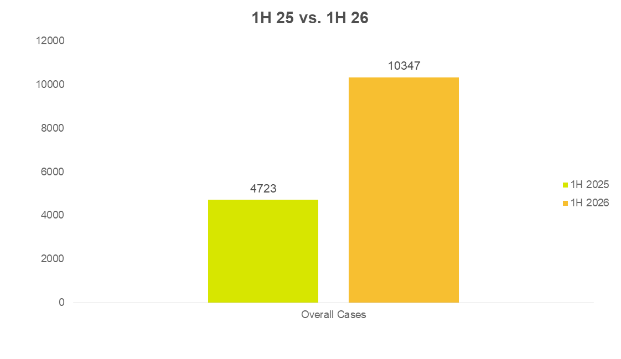

Slide 50
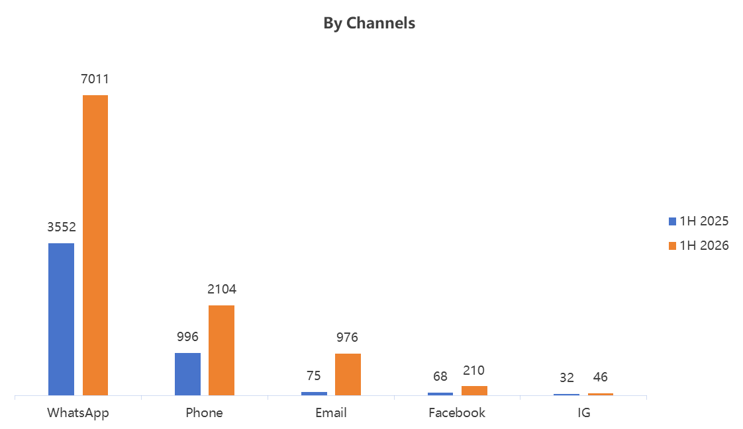

Slide 51
Vehicle Delivery, No Allocation / No ETD / Overpromised ETD
Back & forth exchanges of communication without clear closure.
Dealer always inform customer to check with Pronet HQ via PeC on delivery status
Constant follow up on same case
Customer does not get clear answer on ETD
Suggestion :
1. To inform customer we are unable to handle Vehicle Delivery related issue and suggest them to follow up directly with dealer.
2. We will still follow current flow by escalating to dealer and proceed close case.

Slide 52
2. Refund
Back & forth exchanges of communication without clear closure
Dealer may or may not reply instantly
Customer does not get clear answer on refund status
Suggestion :
To inform customer we are unable to handle deposit refund related issue and suggest them to follow up directly with dealer.
We will still follow current flow by escalating to dealer and proceed close case.

Slide 53
3. No QR Scanner
Dealer did not complete the outbound process in DMS
Dealer may or may not reply instantly
Some cases dealer did not respond with status
4. Change of Phone number / Unable to book assessment
We will escalate to Sales
If there is a need for booking of home assessment, PeC needs to escalate to charging team.
Suggestion :
PeC to escalate to both Sales & Charging Team

Slide 54

Thank you
(Office and Operation Center)
19, Jalan Kuchai Maju,
Kuchai Entrepreneurs Park, 58200, Kuala Lumpur
Tel: 03-7989 0200
Fax 03-7989 0202
www.oneworks.com.my
www.carfix.my
Email: yphen@oneworks.com.my

